Slide 1
Circuits with Capacitors
Click here to add subtitle or something

Slide 2
Units

Slide 3
SI base units we’ll use
Voltage (V): Volts (V) Current (I): Amps (A) Resistance (R): Ohms (Ω)
Energy (U): Joules (J) Time (t): Seconds (s) Power (P): Watts (W)
Capacitance (C): Farads (F) Charge (Q): Coulombs (C)

Slide 4
Power

Slide 5
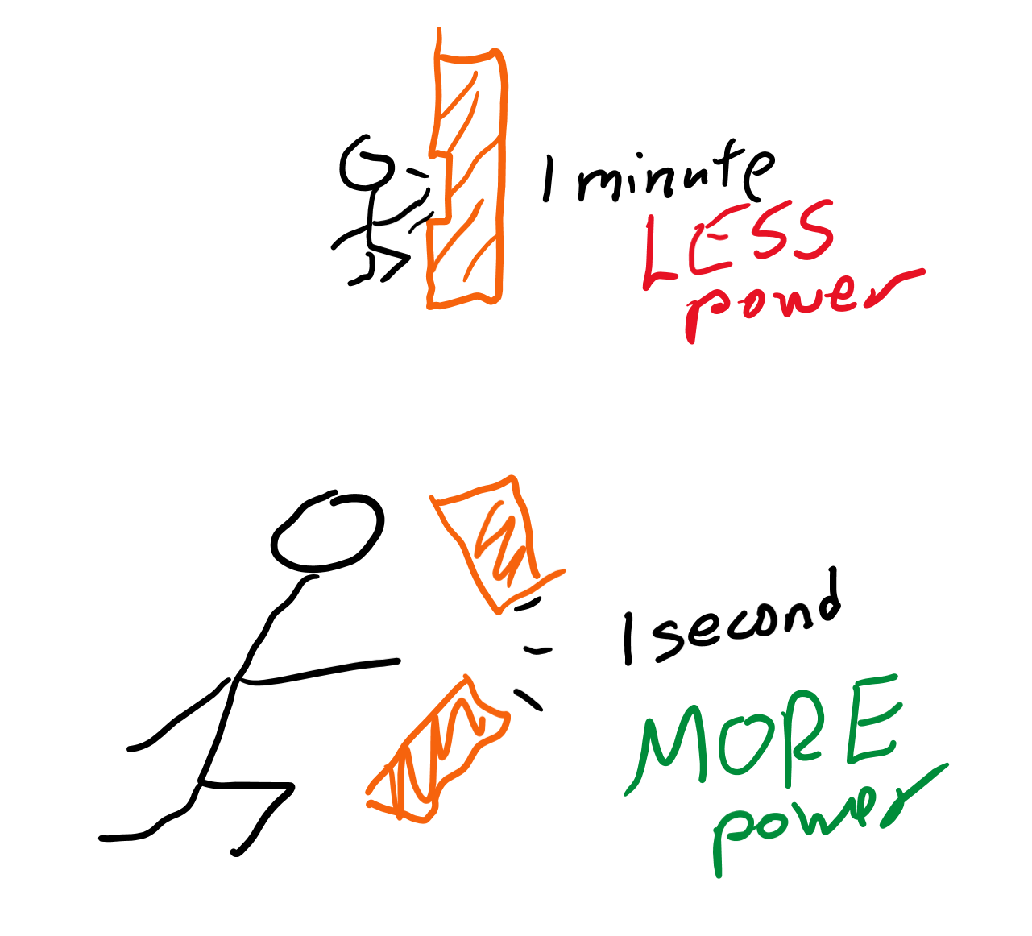
What is power?
What is energy?
What do you think is more “powerful,” a light bulb that produces 500 J of energy in one minute or a light bulb that produces 500 J of energy in one second?
Power is the amount of energy you can produce in a certain amount of time.
If we produced 500 J of energy in 5 seconds, we’d say we have 500/5 = 100 watts of power!

Slide 6
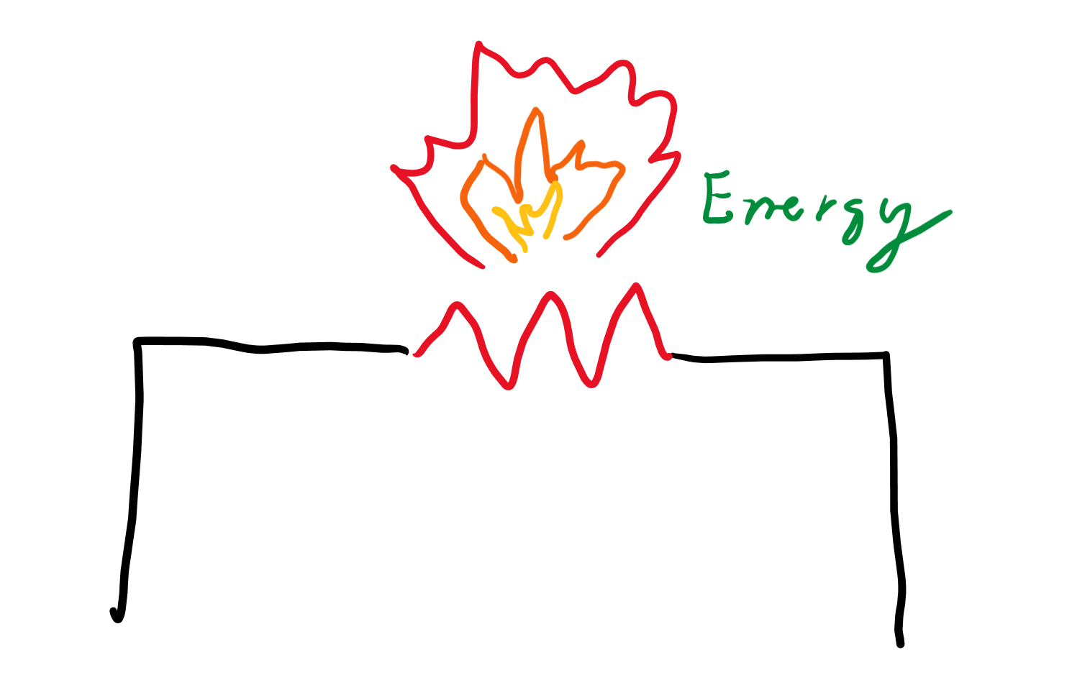
How resistors dissipate energy
When you rub your hands together, what happens?
What happens is by slowing down motion, you turn kinetic energy into heat energy!
If a resistor slows down the flow of charge, what will a resistor produce?

Slide 7
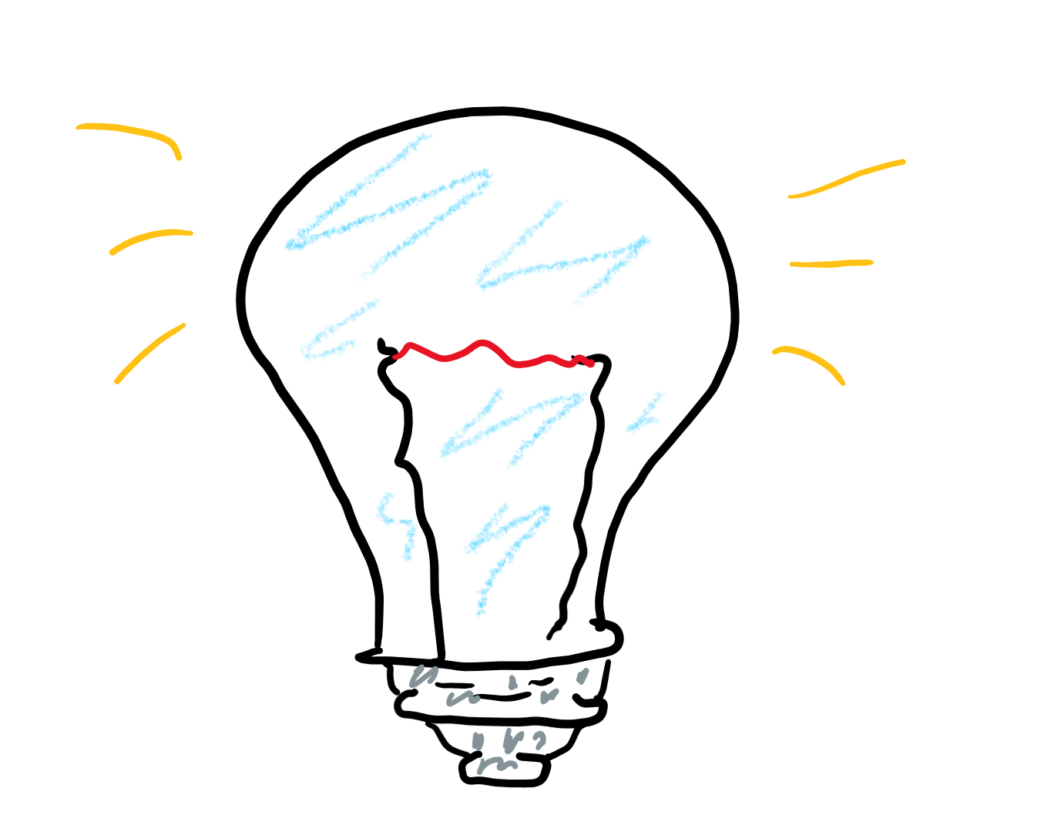
Light bulbs
When you put your hand next to a light bulb, what do you feel?
Heat produced by a light bulb is used to light up a filament!
Why do you think light bulbs stop working?
Oxygen “rusts” the filament that burns, eventually causing the thing to break.

Slide 8
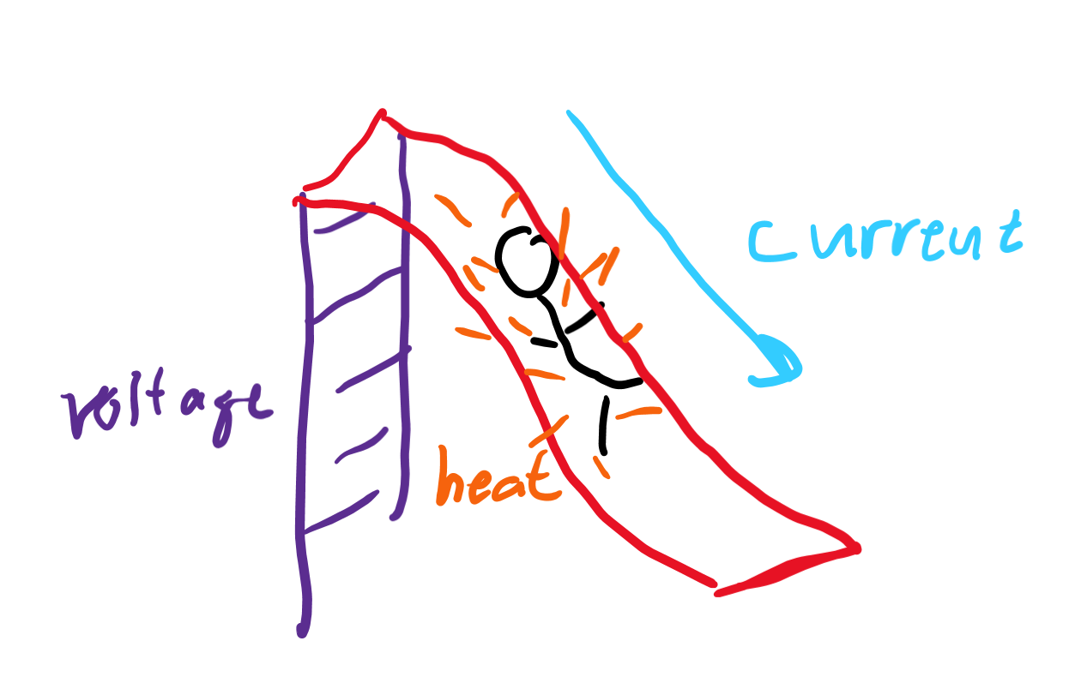
What affects power
If you “push” the current more through a resistor, would you produce more or less power?
If you have more current that’s slowed down, would that produce more or less power?
How would the following affect power:
Increasing voltage
Increasing current

Slide 9
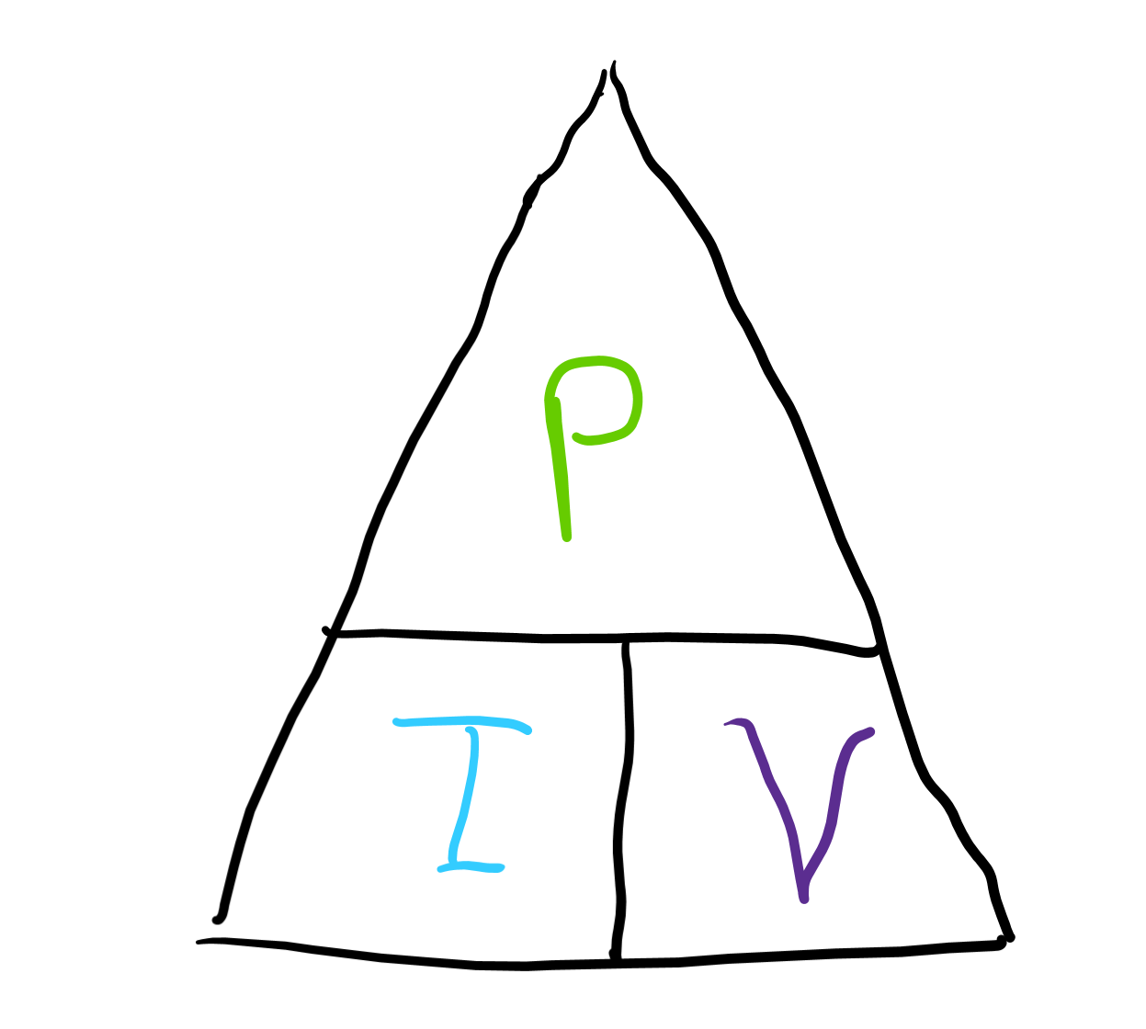
Calculating power
P = IV. If we increase current (I), power (P) goes up. If we increase voltage (V), power also increases.
Remember “Ohm’s” law:
V = IR
I = V/R
Plugging in Ohm’s law also gives:
P = I²R
P = V²/R

Slide 10
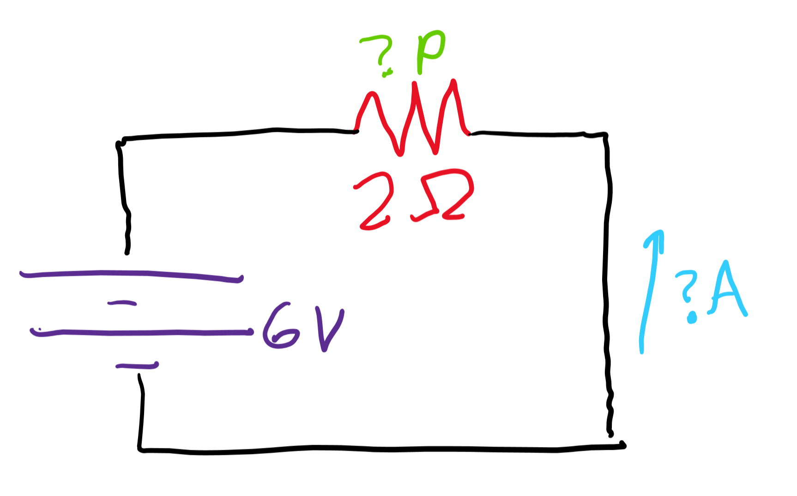
Power example
A voltage source of 6 volts is supplied to a circuit with a single resistor or 2 ohms. What is the current through the resistor?
What is the power dissipated by the resistor?
Answers: By “Ohm’s” law, I = V/R, so I = 6/2 = 3 amps. P = IV, so P = 3*6 = 18 watts.

Slide 11
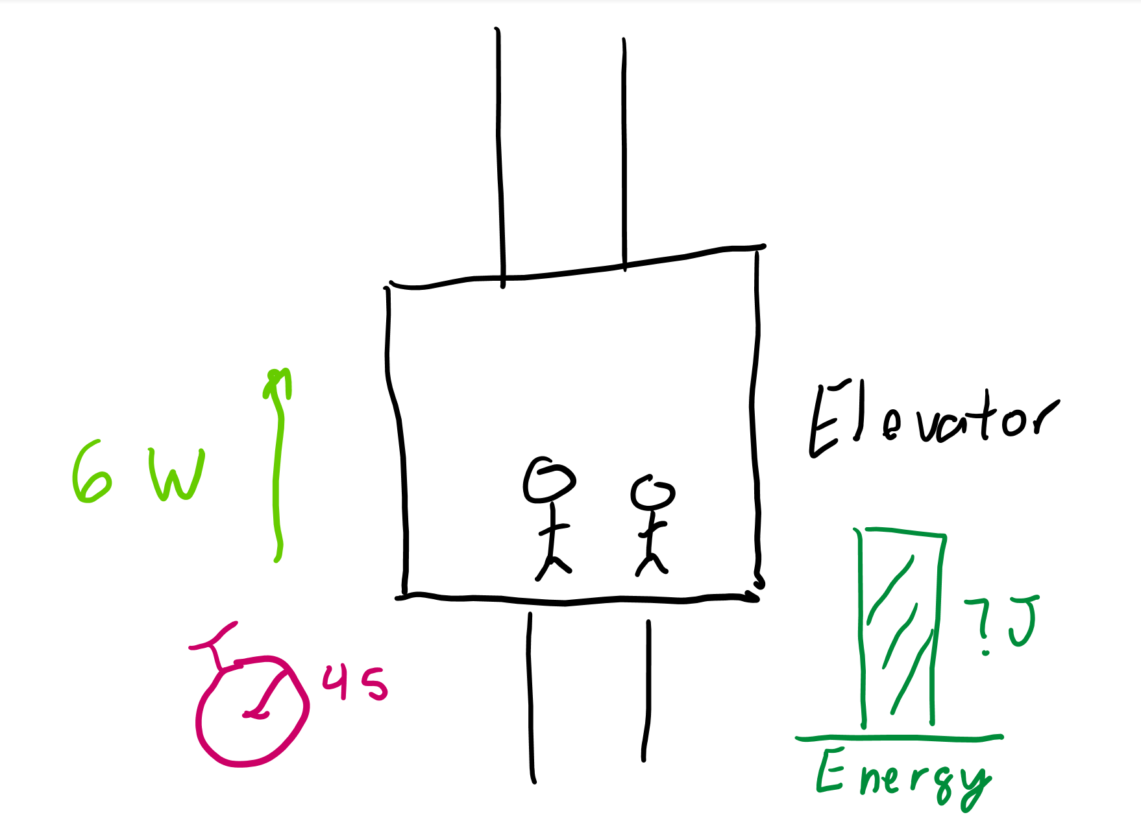
Calculating energy
What was the definition of power again?
If we had 6 watts of power, in 4 seconds, how much energy would we produce?
Answer: 6 watts tells us that every second, we produce 6 joules of energy, so in 4 seconds, we make 6 * 4 = 24 joules of energy!

Slide 12
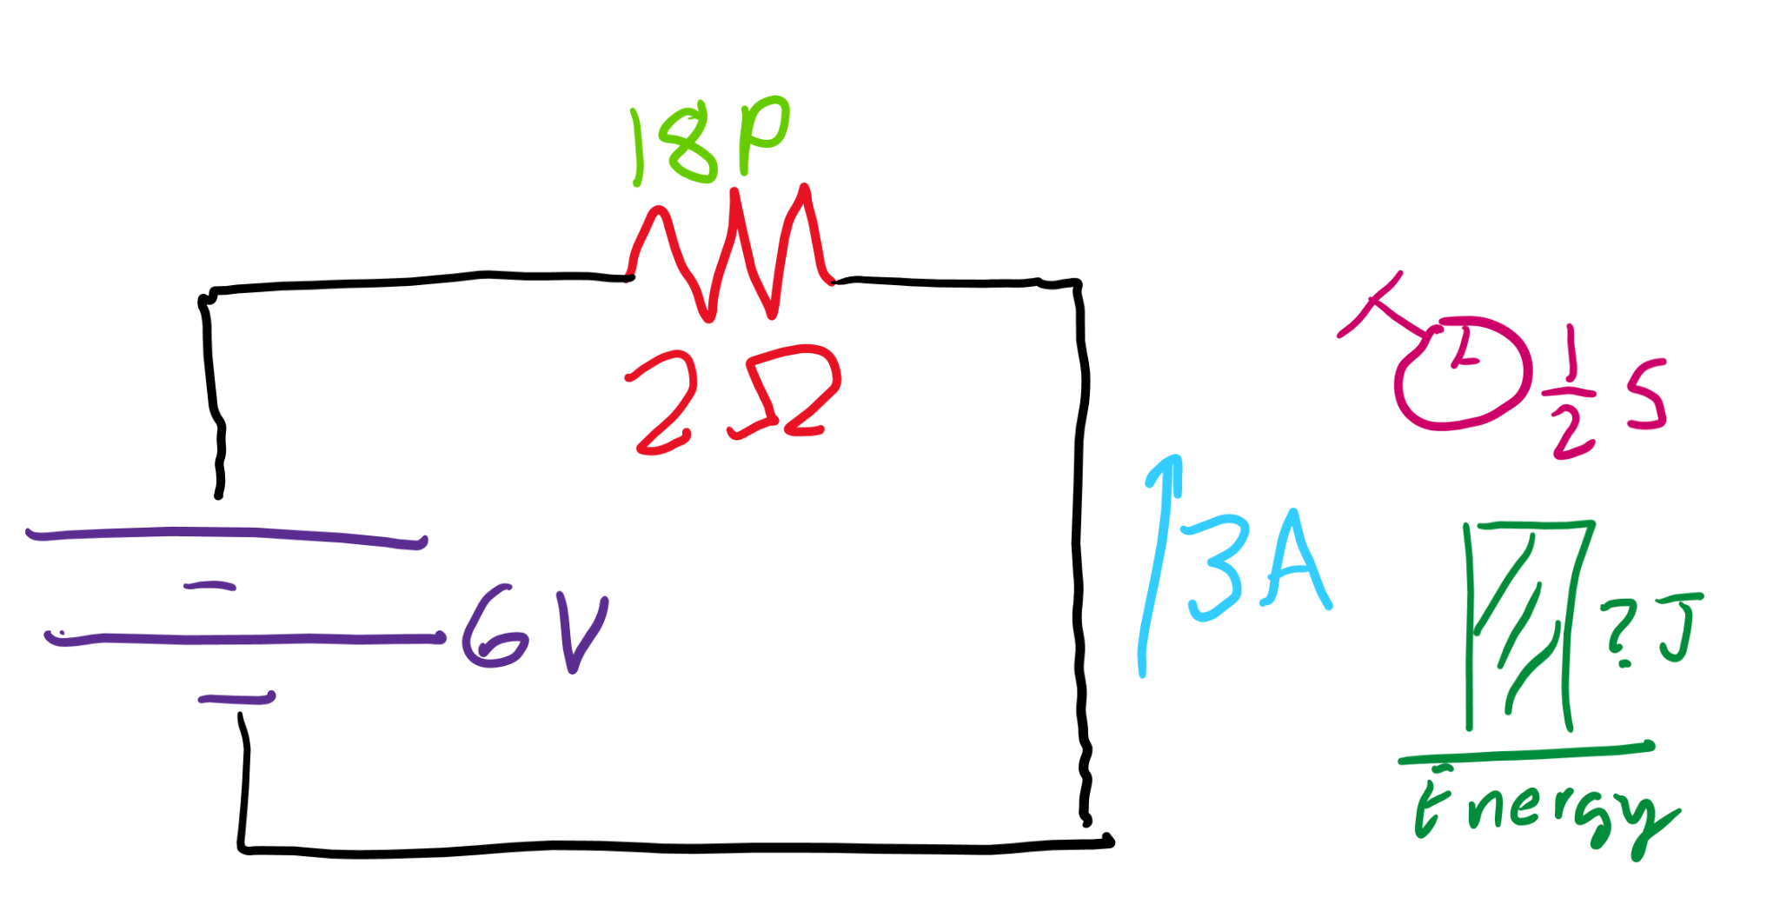
Energy example
Remember our circuit with a 6 volt battery and 2 ohm resistor? How much energy can it produce in half of a second?
Answer: We had 18 W of power, so each second we produce 18 J of energy. In half a second, we’d produce 18 * 1/2 = 9 J of energy.

Slide 13
Capacitors

Slide 14
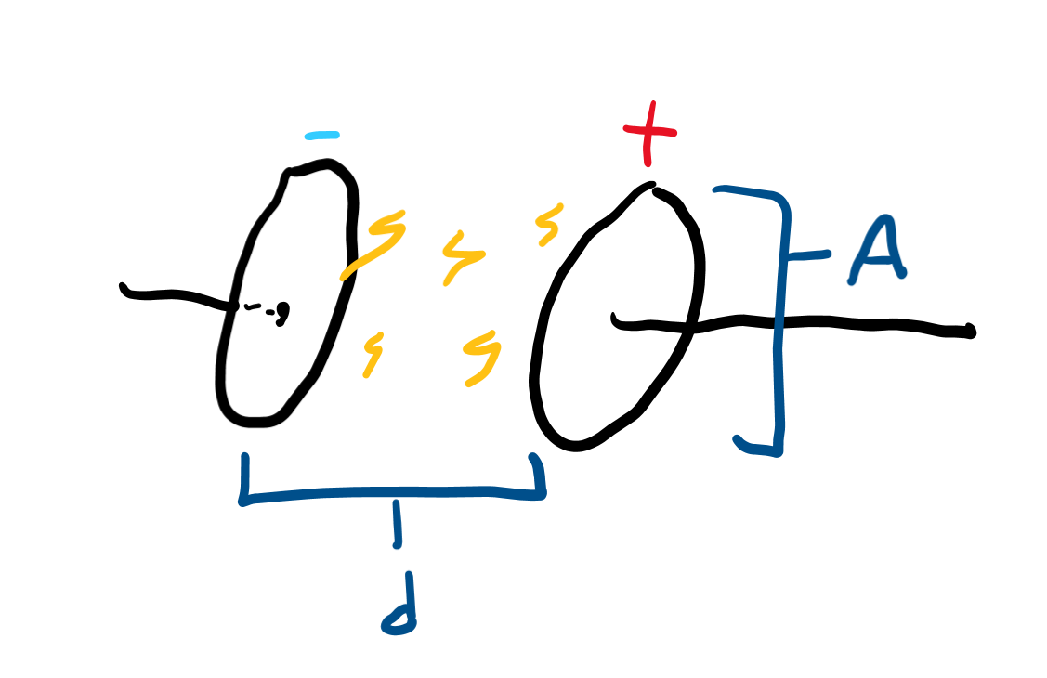
What are capacitors doe?
Made of two plates that store charge against each other.
What kind of energy do they store?
If a battery supplies more voltage, can a capacitor store more or less stuff?
If a battery supplies more voltage, can a capacitor store more or less stuff?
What kinds of things make good capacitors?

Slide 15
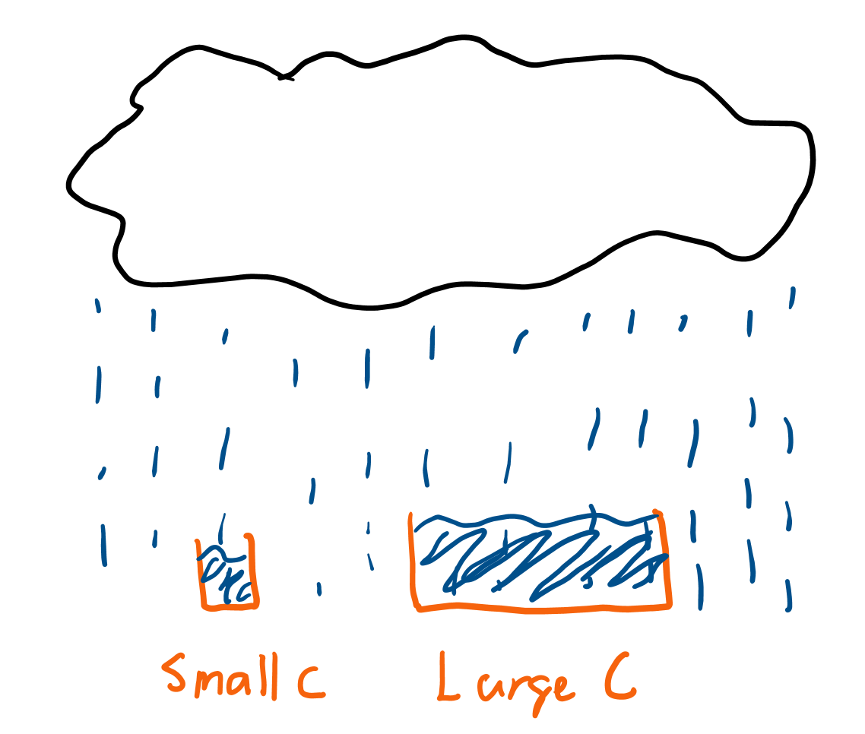
Calculating charge on a capacitor
Q = CV because if you increase the capacitance (C) or the voltage (V), you increase the charge.
What do you think make good capacitors? (Hint: think the opposite of resistors.)
You can increase capacitance by:
Increasing area
Decreasing distance between plates

Slide 16
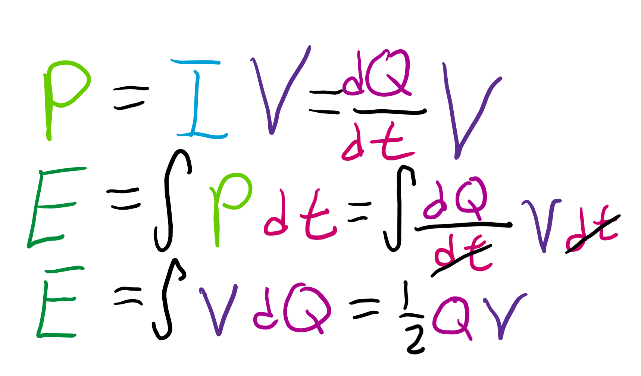
Calculating energy on a capacitor
Energy is based on the charge and voltage across a capacitor: E = ½ QV
If we plug in Q = CV, we get two more:
E = ½ CV²
E = ½ Q²/C

Slide 17
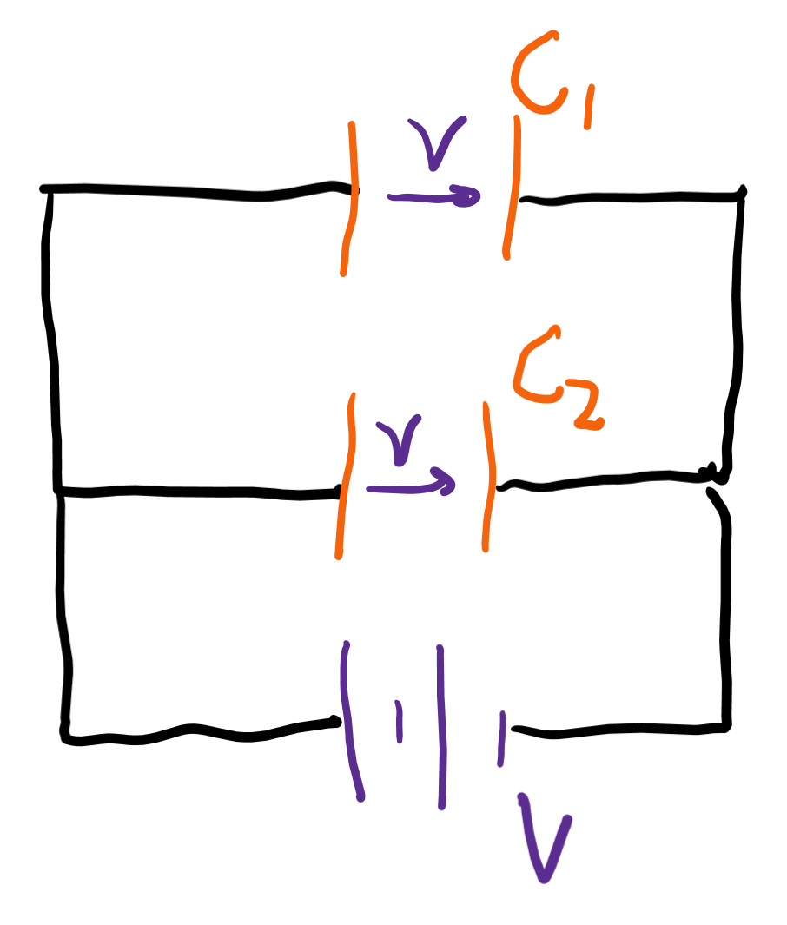
Combining capacitors (parallel)
Voltages across parallel tracks do not affect each other (by Kirchhoff’s second law). Thus, CV₁ + CV₂ = Q₁ + Q₂.

Slide 18
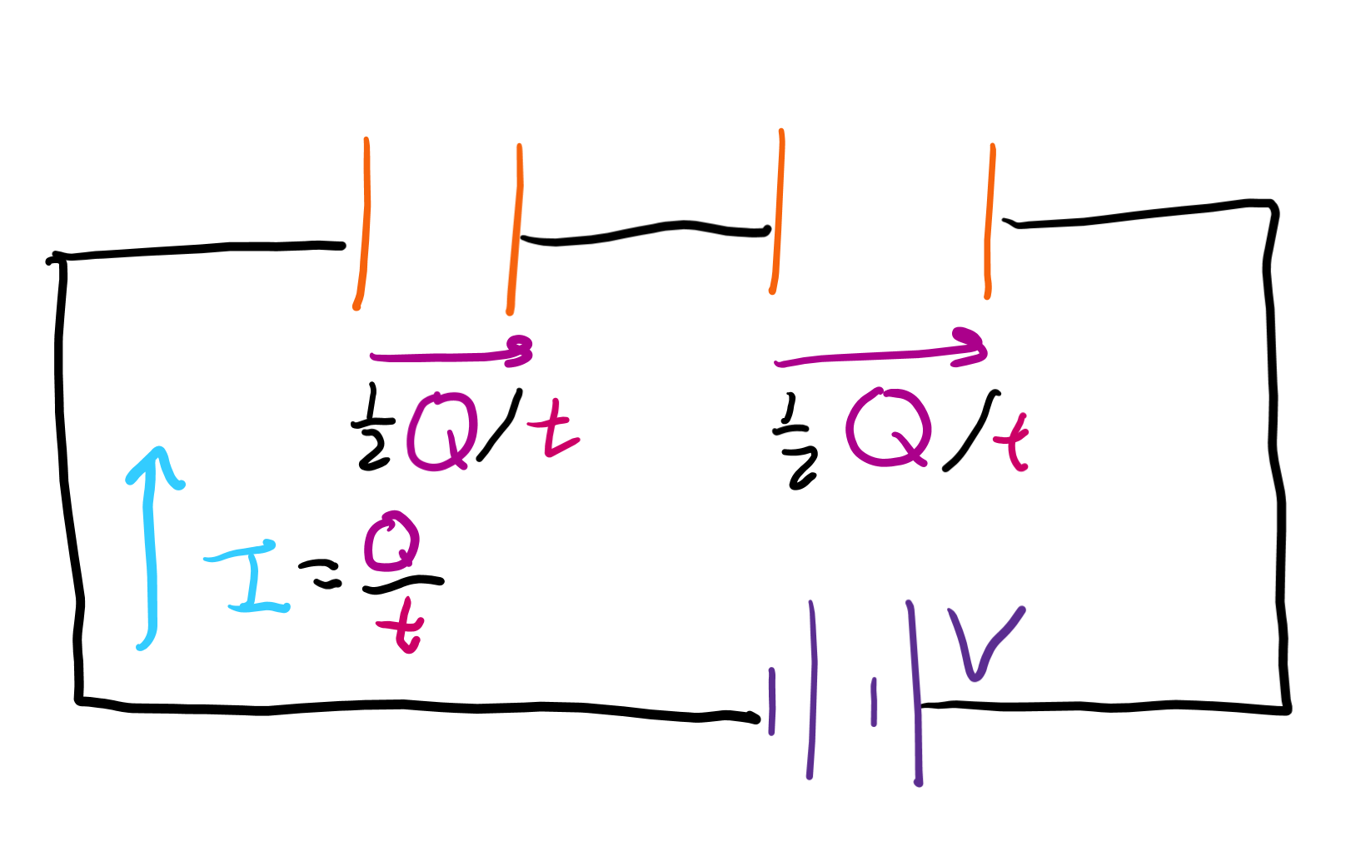
Combining capacitors (series)
Voltages drop across each capacitor in series, so the amount of Q = CV decreases each capacitor in series.

Slide 19
RC circuits

Slide 20
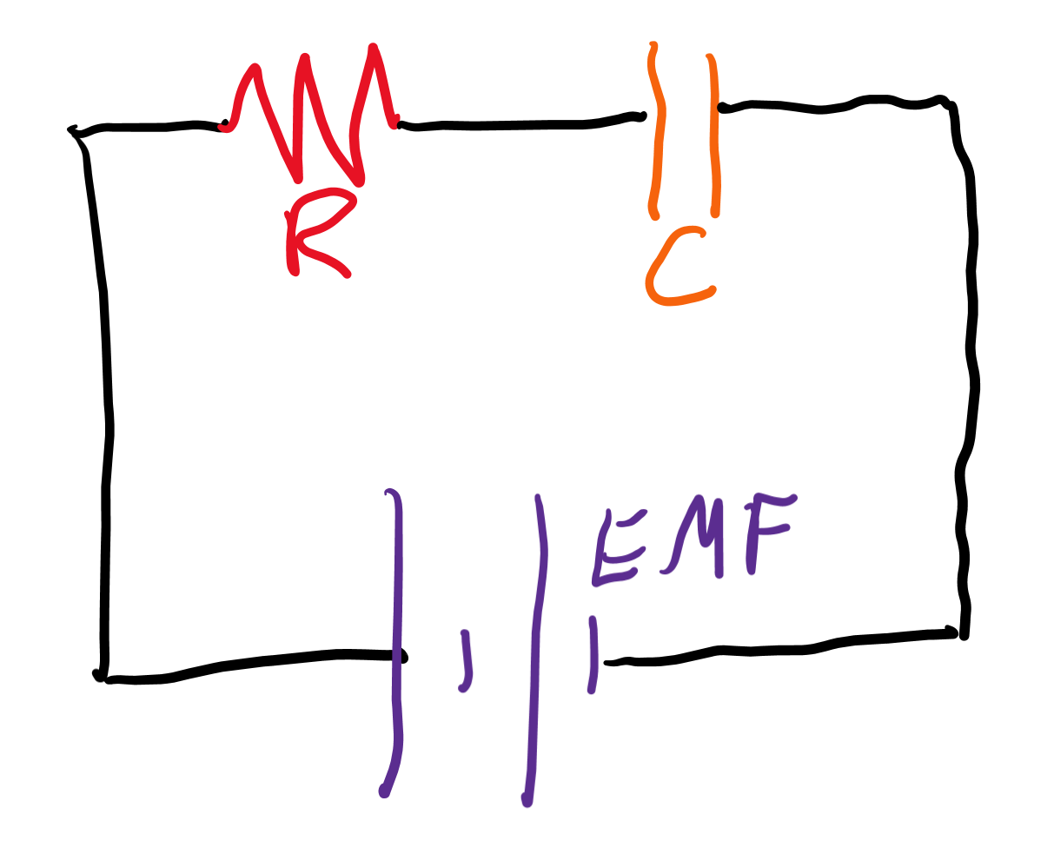
What do the R and C stand for?
Resistors ® and Capacitors © !!!

Slide 21
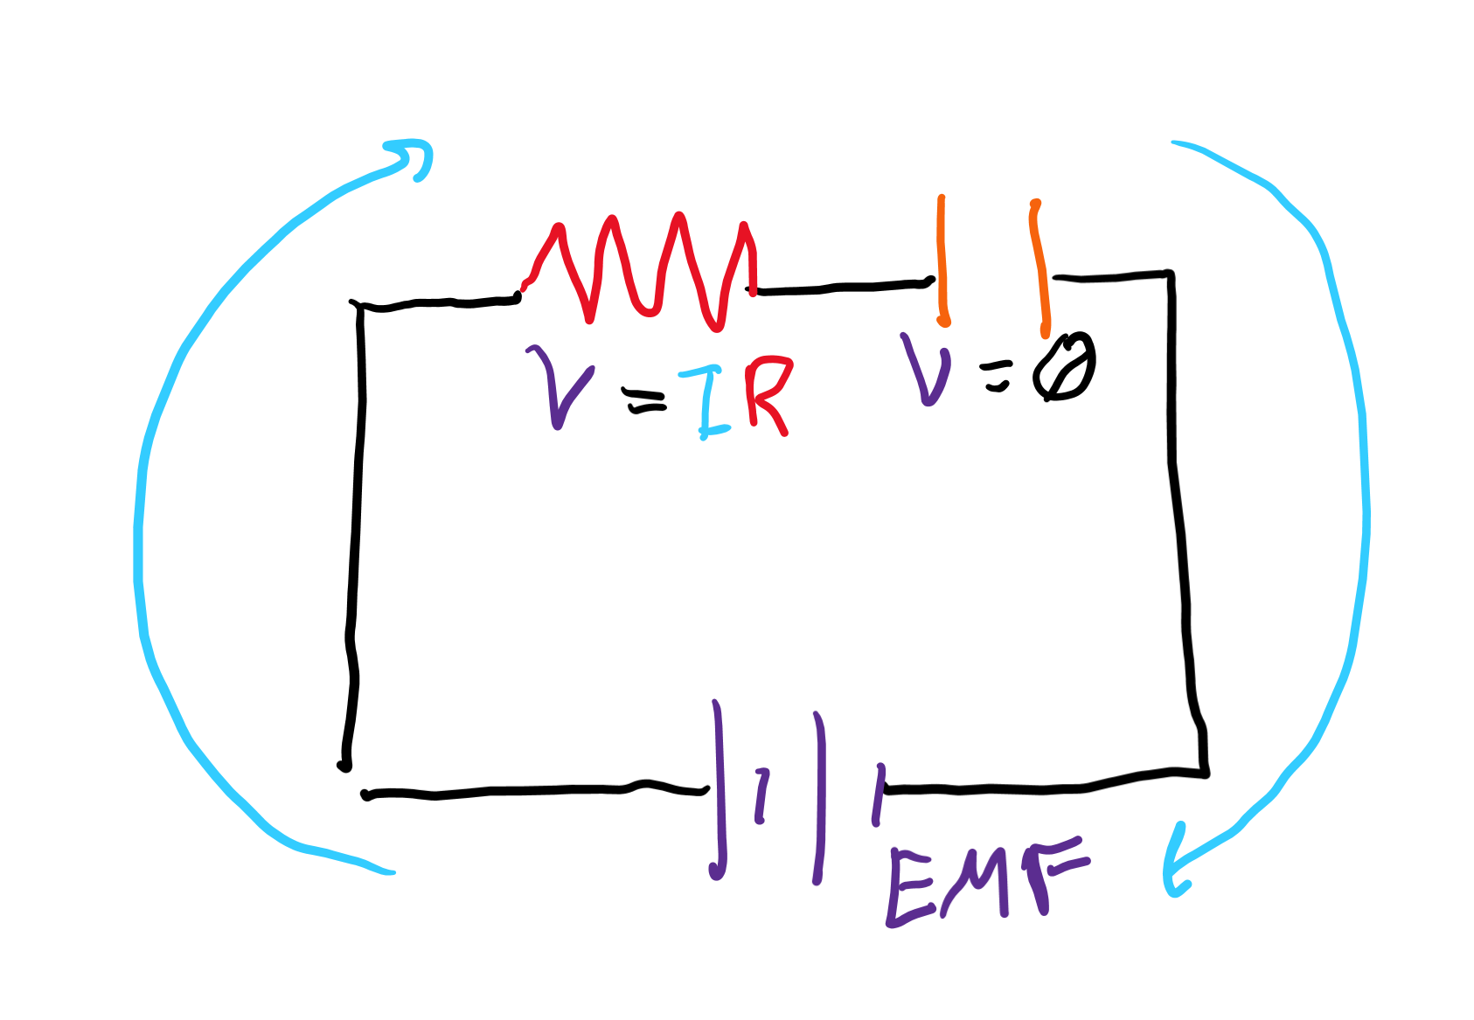
How does a capacitor get charged?
What supplies the voltage?
Where does the voltage from the battery go when the capacitor is empty?
(Hint: only R and C can drop voltage, and if the capacitor is empty, the C isn’t dropping any voltage.)

Slide 22
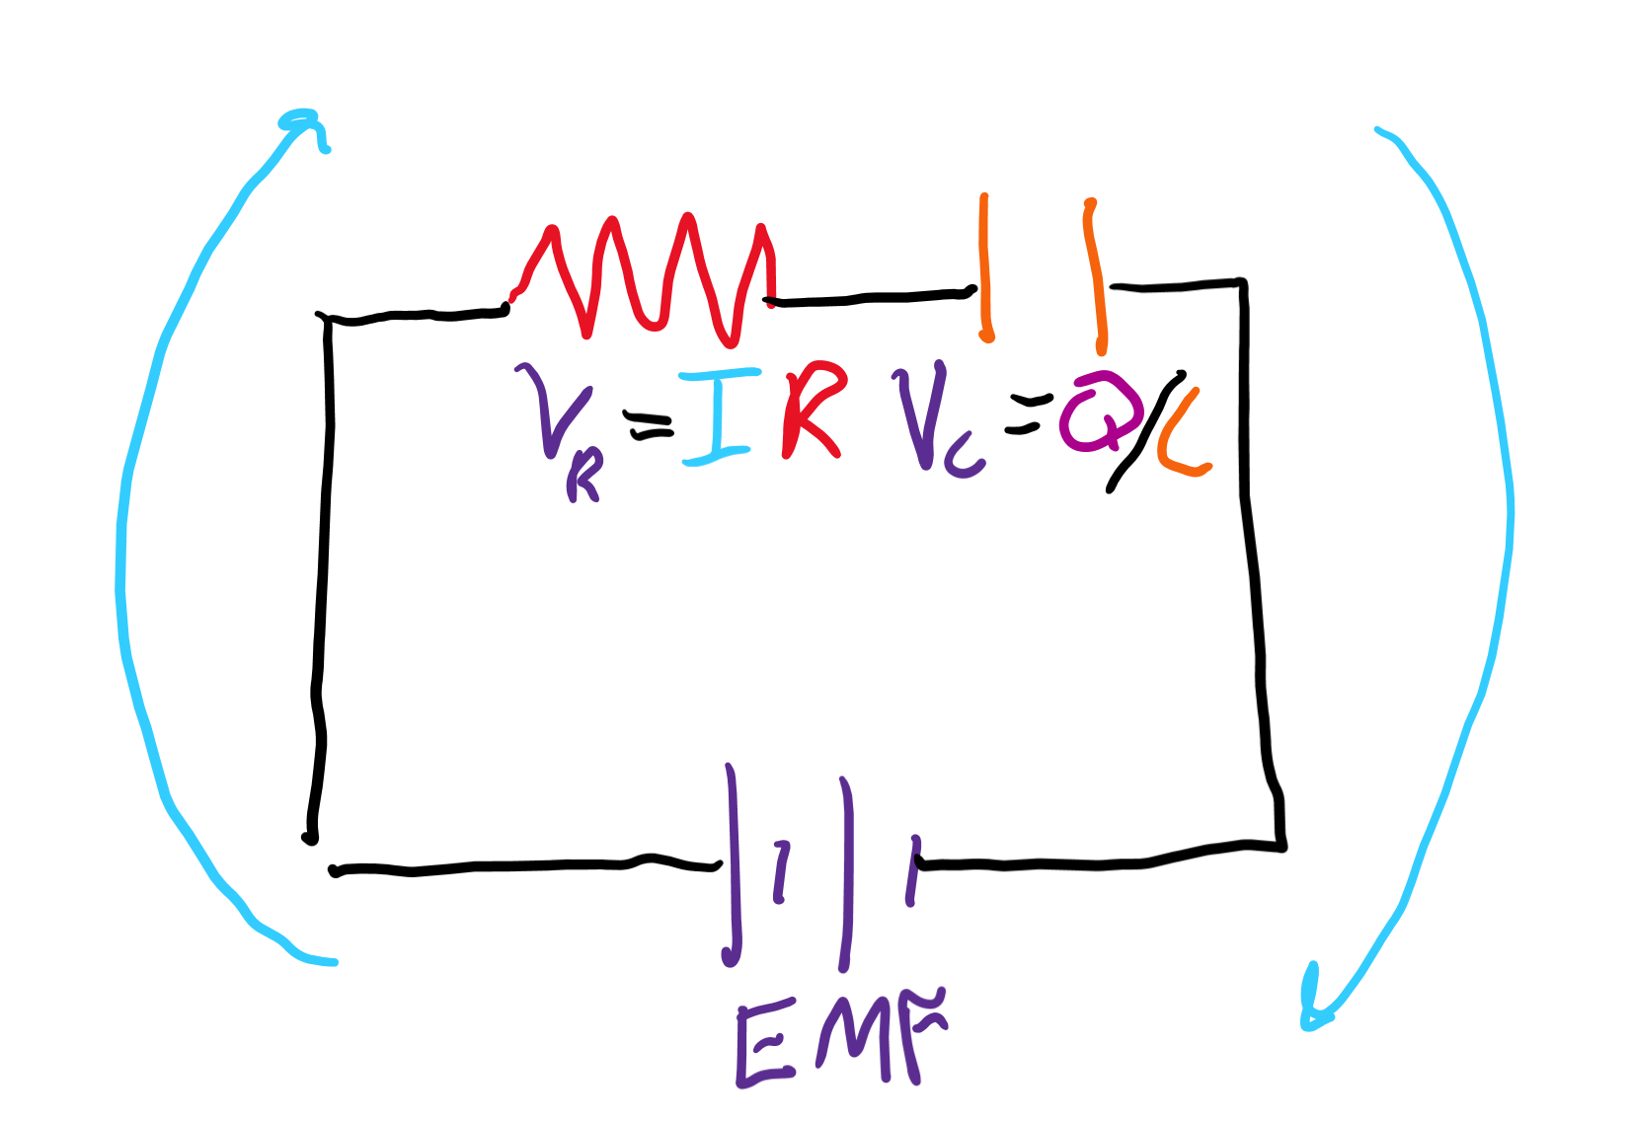
Kirchhoff’s second law pt. 1
The voltage supplied is from the battery. We call this voltage the EMF.
The resistor drops some of that voltage. The amount of voltage dropped is V_{R} = IR.
The capacitor drops the rest of the voltage. The total amount of voltage the capacitor can drop is V_{C} = Q/C.
Thus, EMF = V_{R} + V_{C} = IR + Q/C.

Slide 23
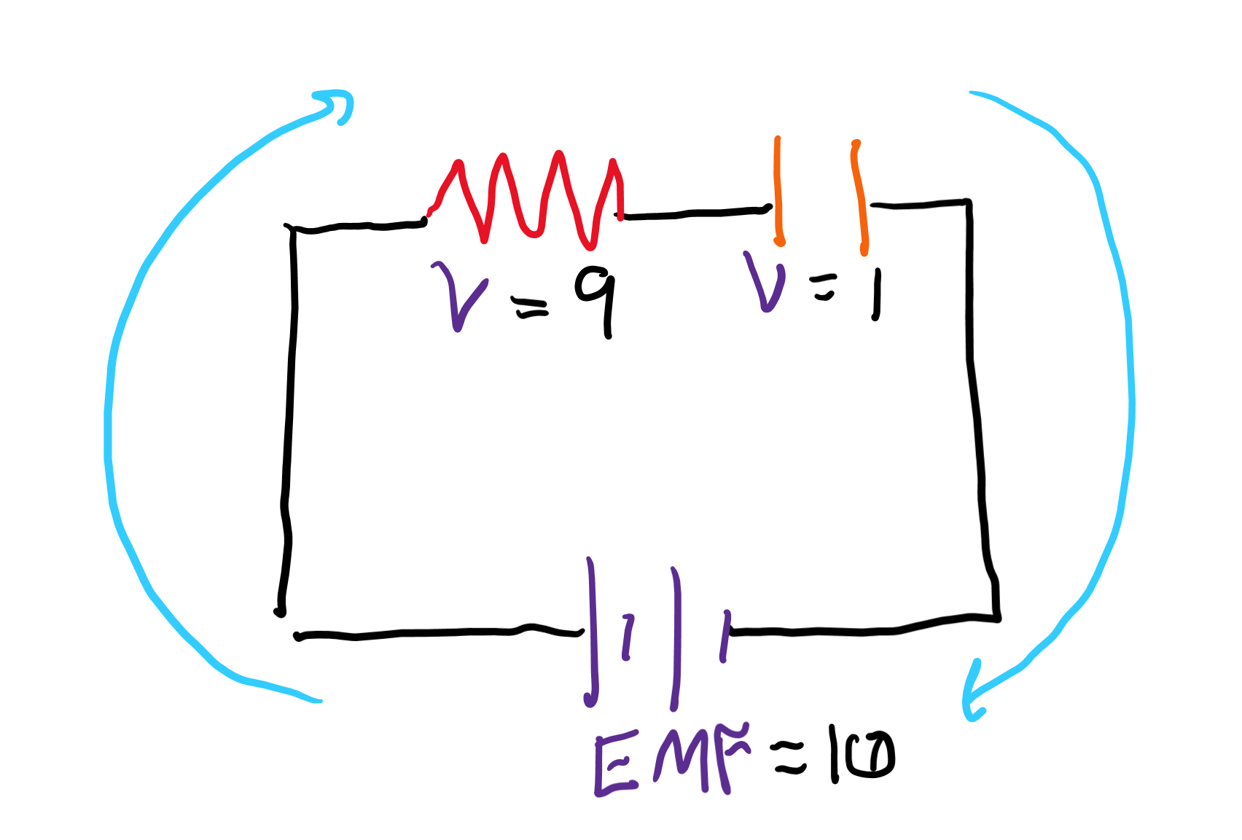
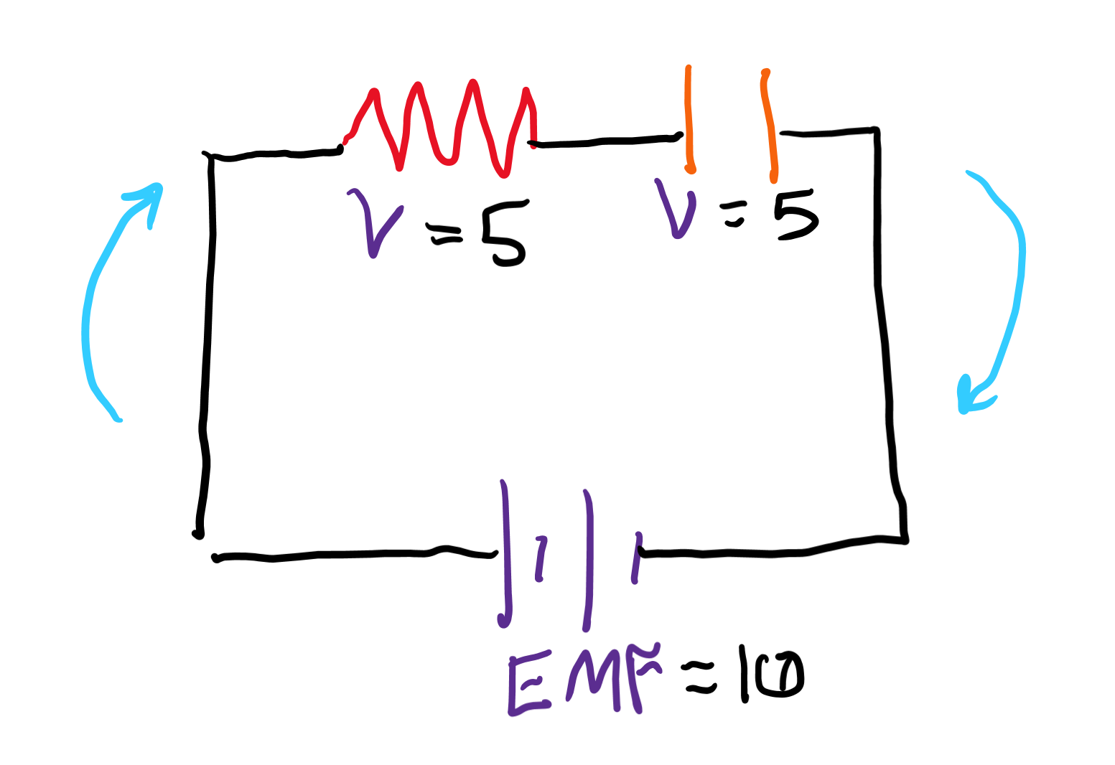
What happens to current?
When a capacitor charges, what happens so the voltage across the resistor?
(Hint: remember that the only things that drop voltage are the R and C. If C drops more and more voltage, what happens to the amount R can drop?)
What does “Ohm’s” law tell you about the current if the voltage across the resistor is dropping?

Slide 24
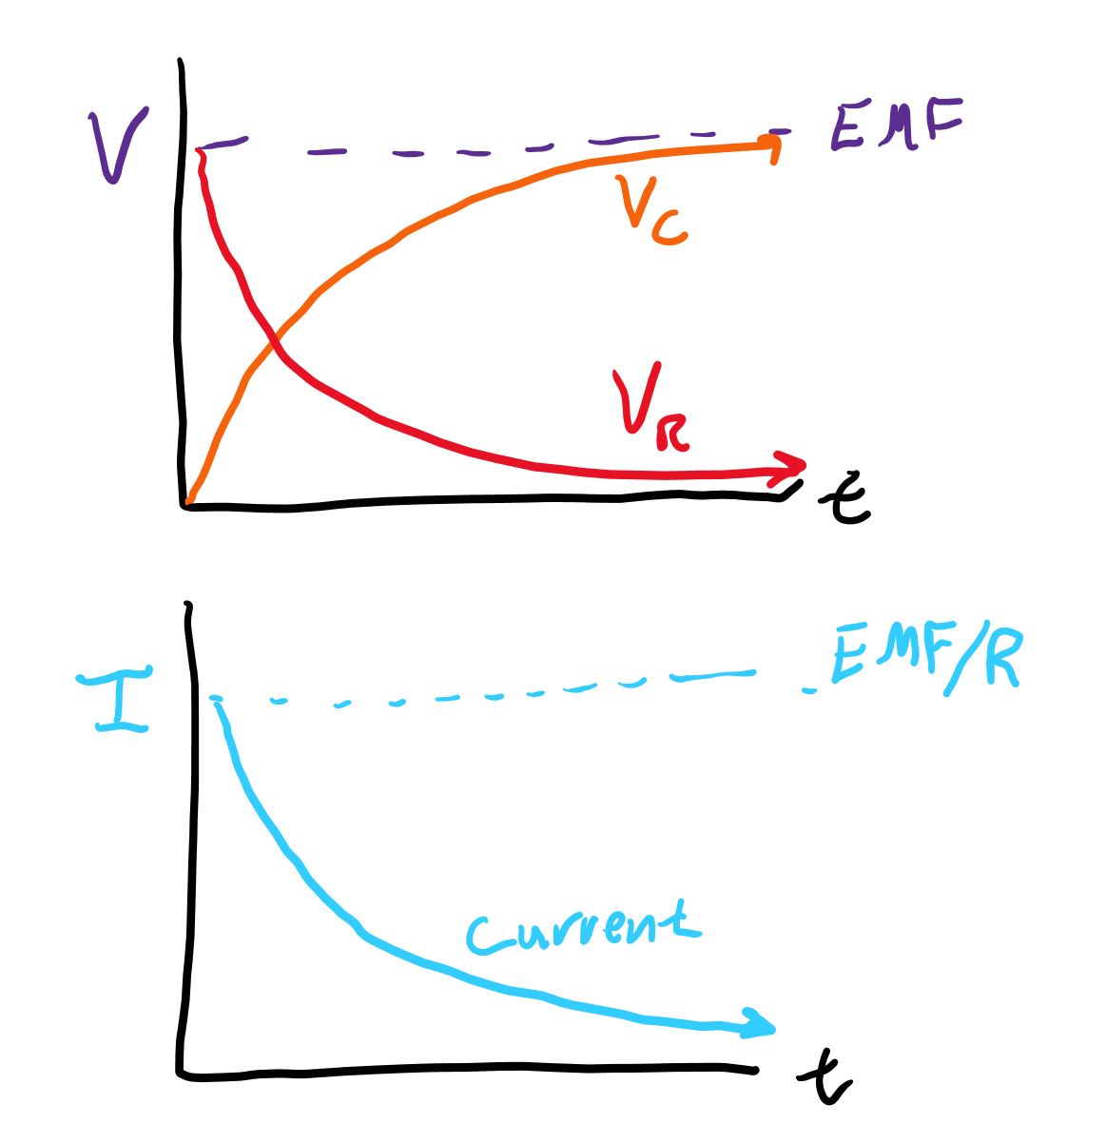
Graphs of what happens
As the capacitor charges, the voltage across it increases while the voltage across the resistor decreases. The current also decreases.

Slide 25
Discharging circuit

Slide 26
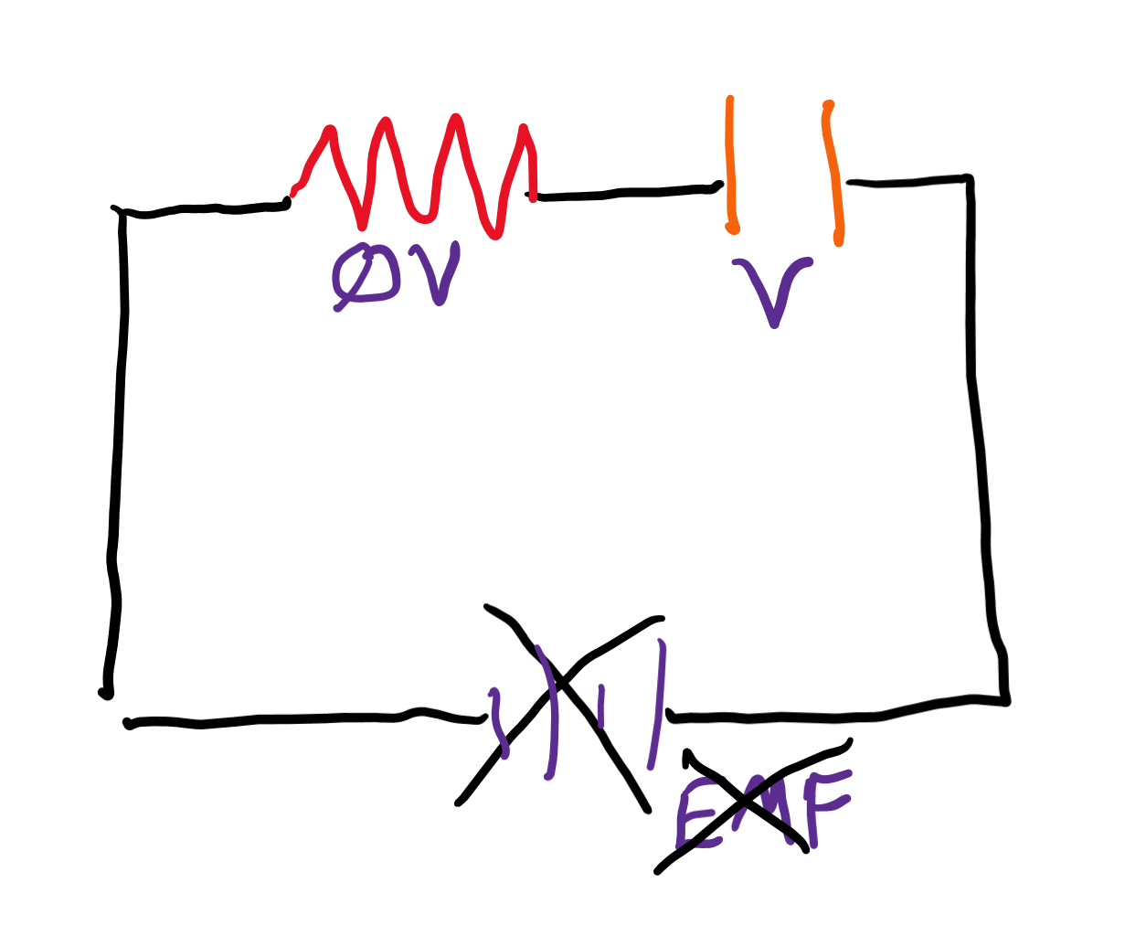
What happens when we remove the battery?
What is the total supplied voltage from batteries if no battery is in the circuit?
What is the new voltage source since the battery supplies none?

Slide 27
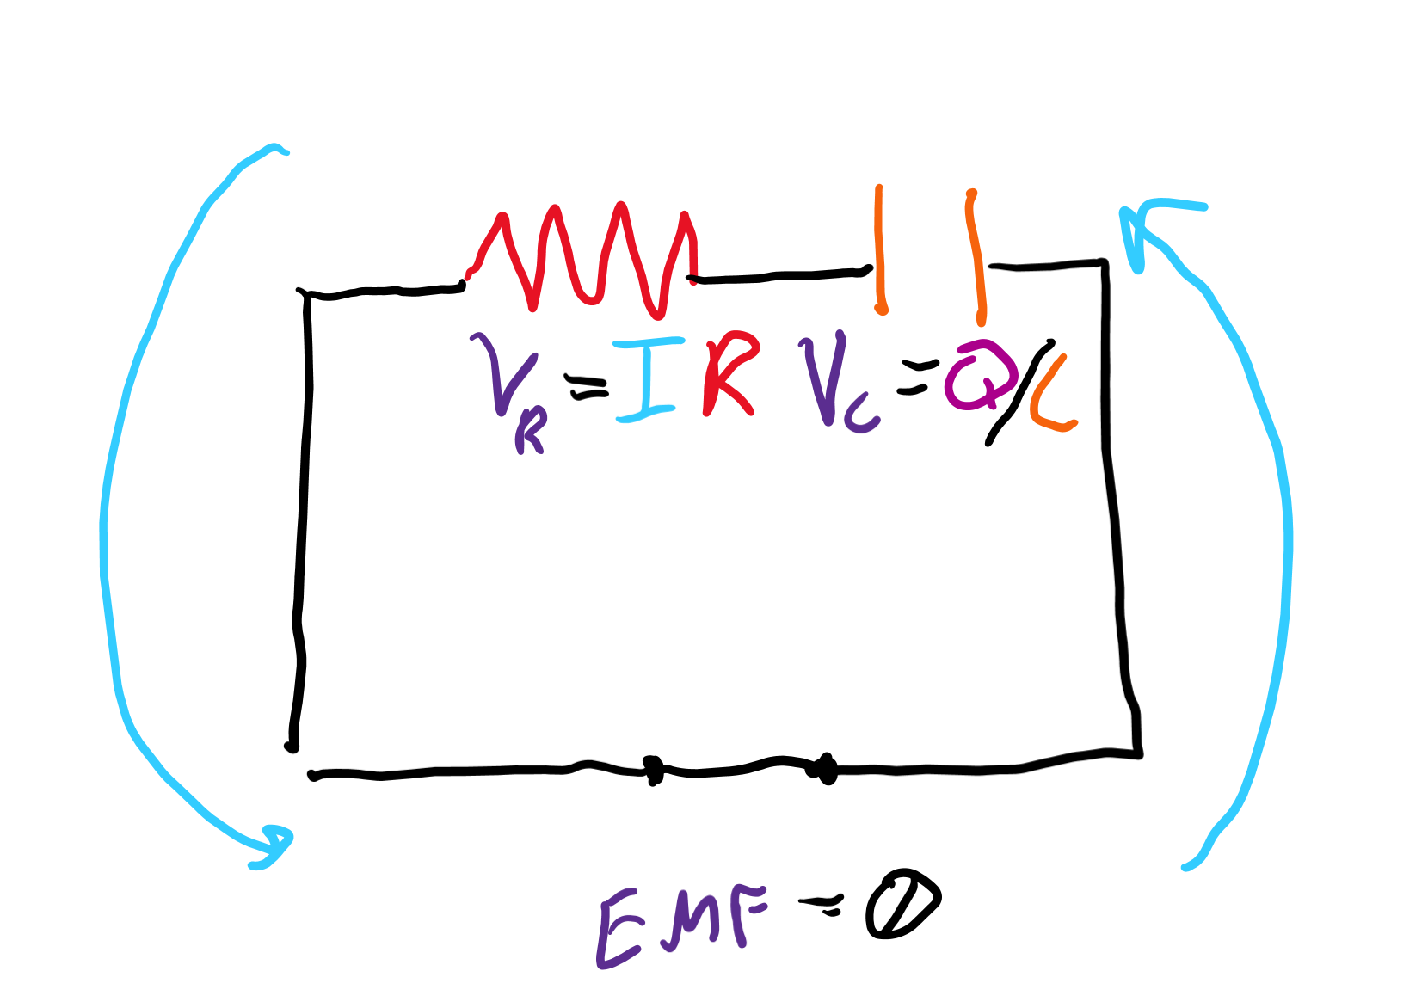
Kirchhoff’s second law pt. 2
Since the battery supplies no voltage, we know V_{R} + V_{C} = 0 V, so V_{R} = IR = -V_{C}.
This rearranges to I = -V_{C}/R, telling us our current is actually moving in the opposite direction now!

Slide 28
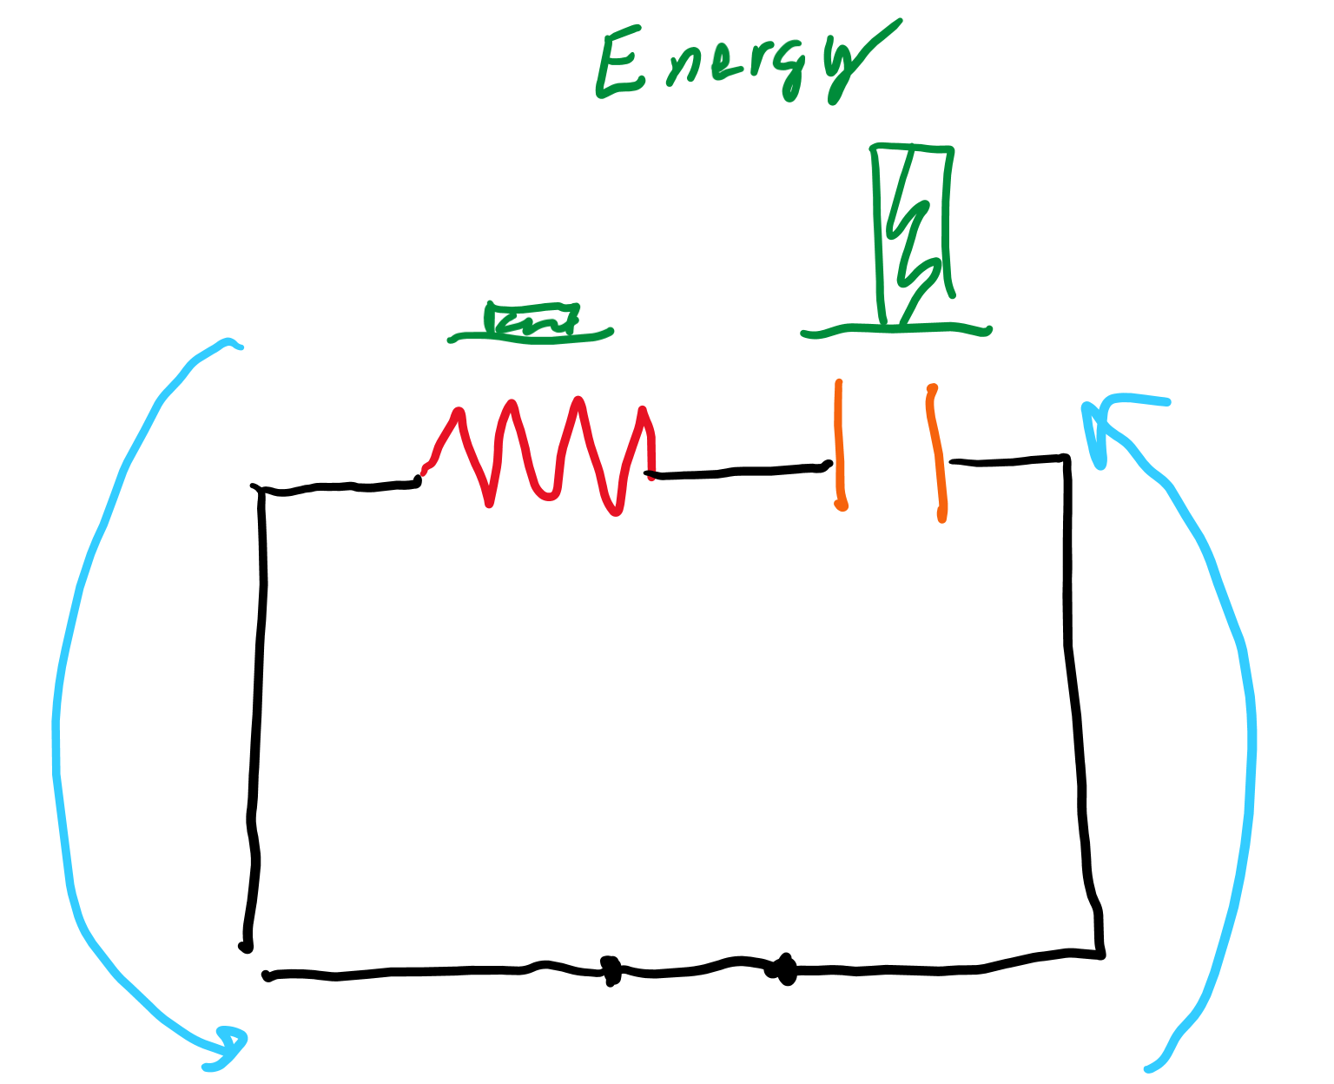
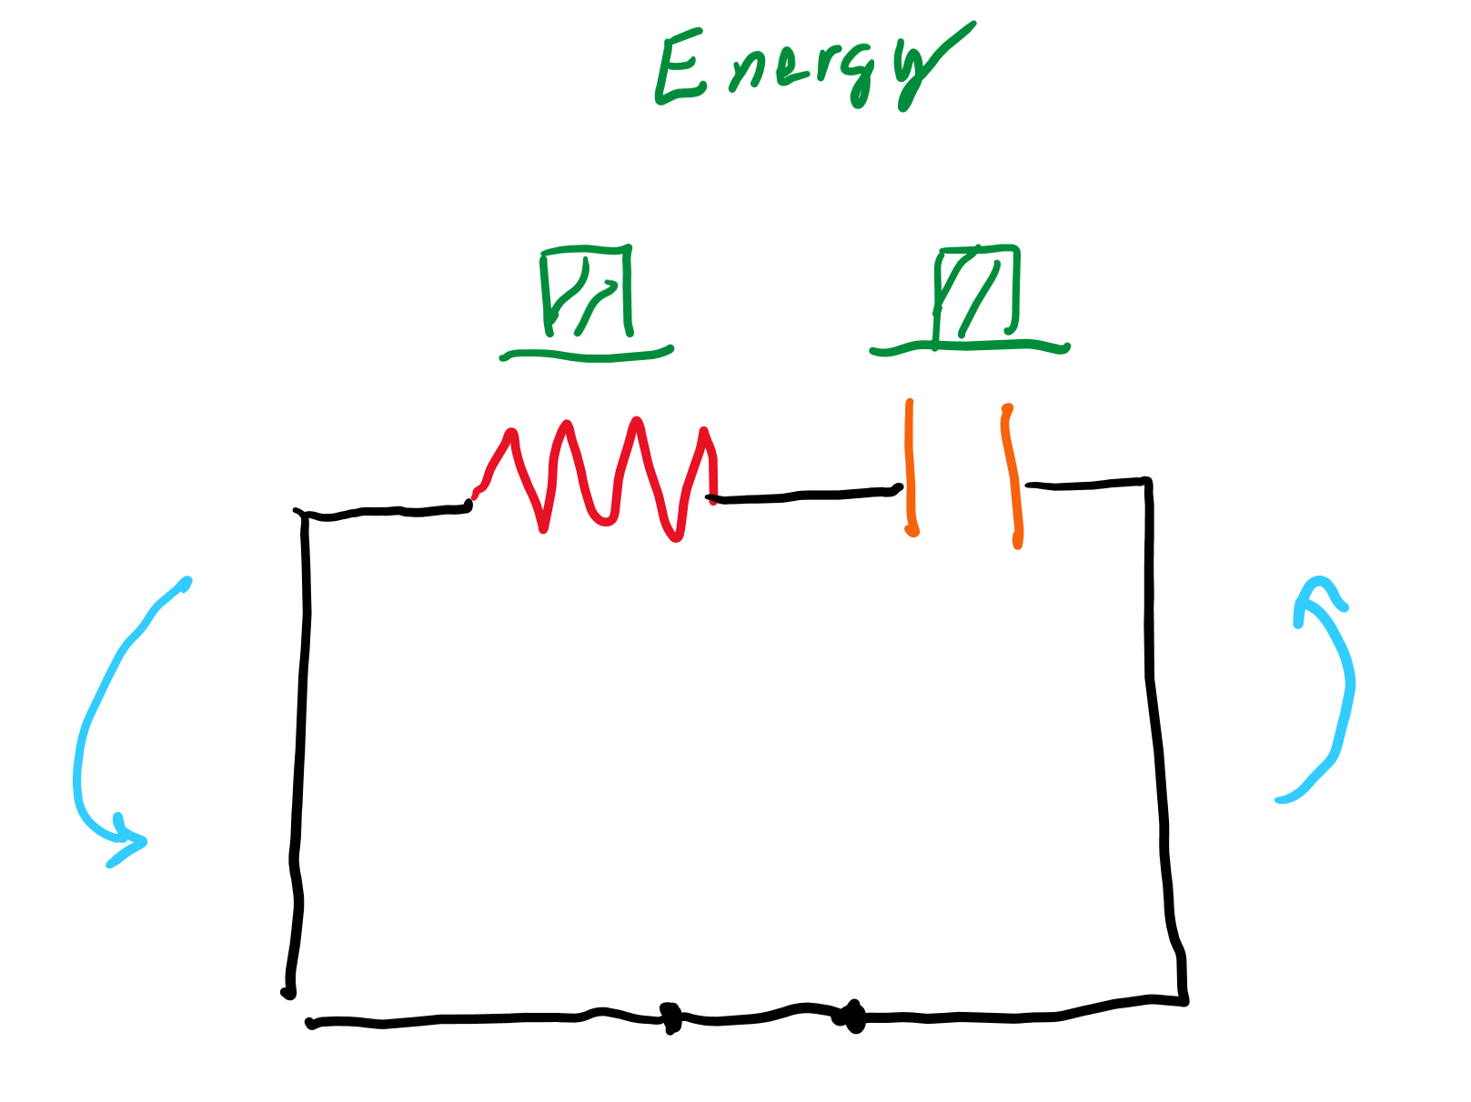
What happens to the energy in the capacitor?
Since current will now be flowing through the resistor, energy is lost through the resistor. Where did that energy come from?
The capacitor must lose energy as it discharges.

Slide 29
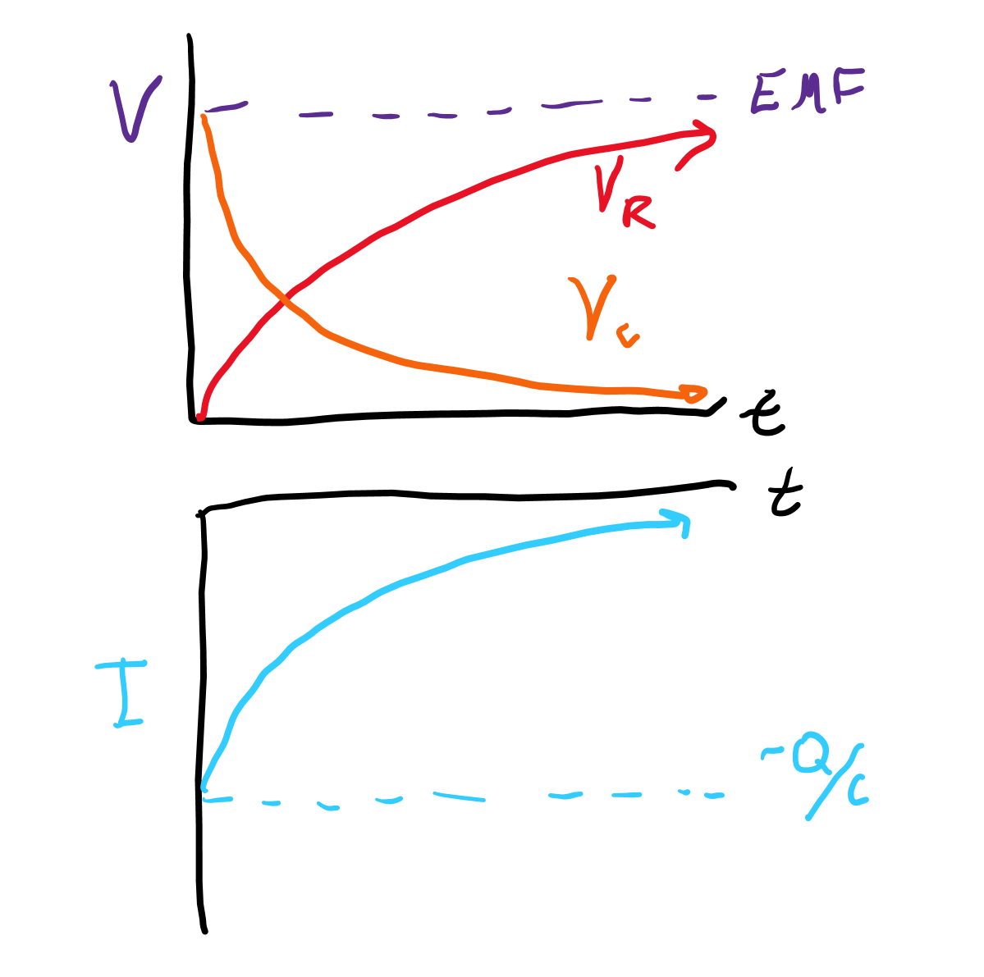
Graphs of the situation
As soon as the battery is removed, current begins to flow in the opposite direction, causing the voltage across the resistor to jump up. The voltage across the capacitor decreases as does the voltage across the resistor. The current begins to decrease over time as the capacitor loses charge.

